Slide 1
Dropout的隐式正则化
许志钦
2023年11月13日

Slide 2
回顾参数凝聚

Slide 3
Is NN really so complex?

Slide 4
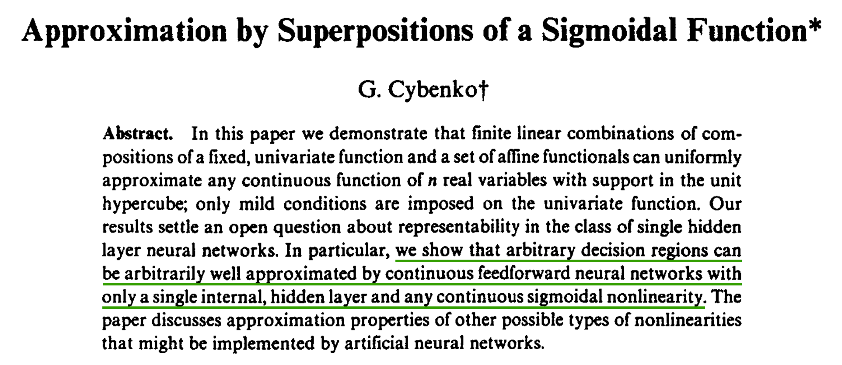
Universal approximation theorem (UAT)
1989
Yes, NN is complex!
But, polynomial fitting also has UAT!

Slide 5
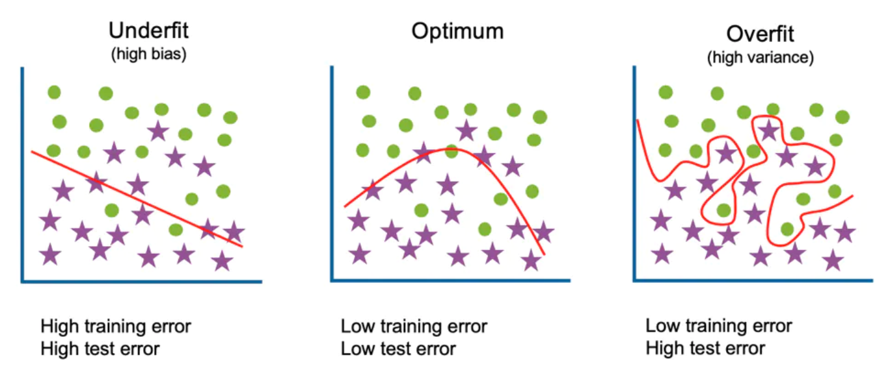
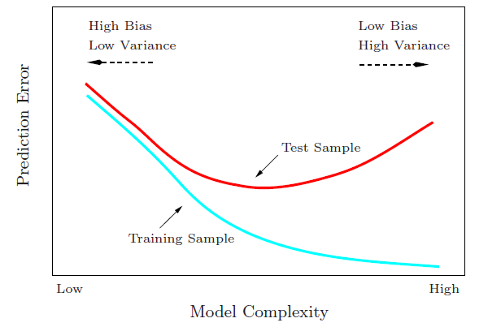
Start from traditional generalization gap
Large complexity → Large generalization gap
Generalization Gap
Traditional wisdom: Too complex is trouble

Slide 6
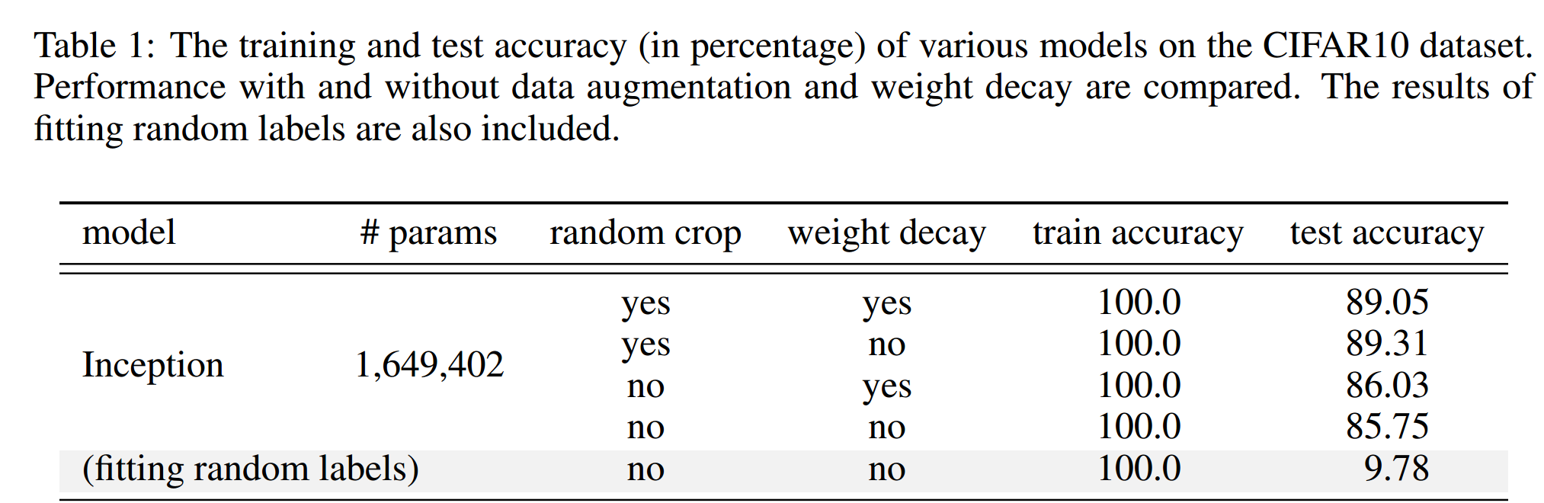
A generalization puzzle arises in deep learning
Puzzle: generalize well even # of para >> # of training data
60000 32x32 colour images in 10 classes
This trouble ignores deep learning?
L. Breiman 1995, Zhang et al., 2016

Slide 7
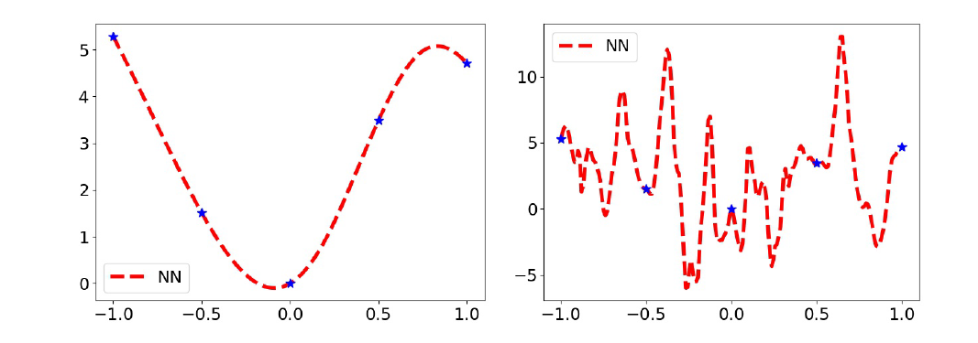
Over-parameterized NN can be good/bad
There are many solutions for fitting training data!

Slide 8
Is NN really so complex in practice?

Slide 9

Generalization error analysis
No free lunch theorem: I can find a dataset that your method generalizes badly.
Algorithm features
Data features
Consistent???

Slide 10
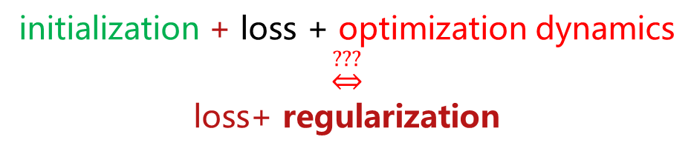
Implicit regularization helps understanding algorithms
Traditional optimization
Explicit regularization
Loss + L1/L2/…
e.g., L1: sparse
L2: low energy
Neural network
Implicit regularization
All feasible solutions
initialization + loss + optimization dynamics
$$\underset{⇔}{???}$$
loss+ regularization
Notes:
下面，我们来解释隐式正则化的概念。在传统的优化中，很多时候满足损失函数最小的解有很多，许多研究工作会根据问题的特点添加正则化条件来确定解，比如对于稀疏问题，可以加L1，对于能量最小化问题可以添加L2。正则化条件不仅帮我们选择到唯一的解，重要的是它提供了一种可解释性，它决定了模型在何种问题可以有好的泛化性。
而在神经网络中，我们是通过选择初始化、损失函数的类型以及不同优化方法带来的训练动力学，最终从所有可行解中选择一个解。如果这些选择可以等价成一个损失函数加上正则化，那我们就可以通过这个正则化条件来理解神经网络在什么问题有好的泛化性，在什么问题有局限性。这个正则化由于不是显示地在训练过程中添加的，因此，也被称为隐式正则化。

Slide 11
Picture of deep learning with implicit bias
initialization + loss + optimization dynamics
Low frequency
Linear regime
Non-Linear regime
Nearest
solution
Condensation
Global minima
Parameter space

Slide 12
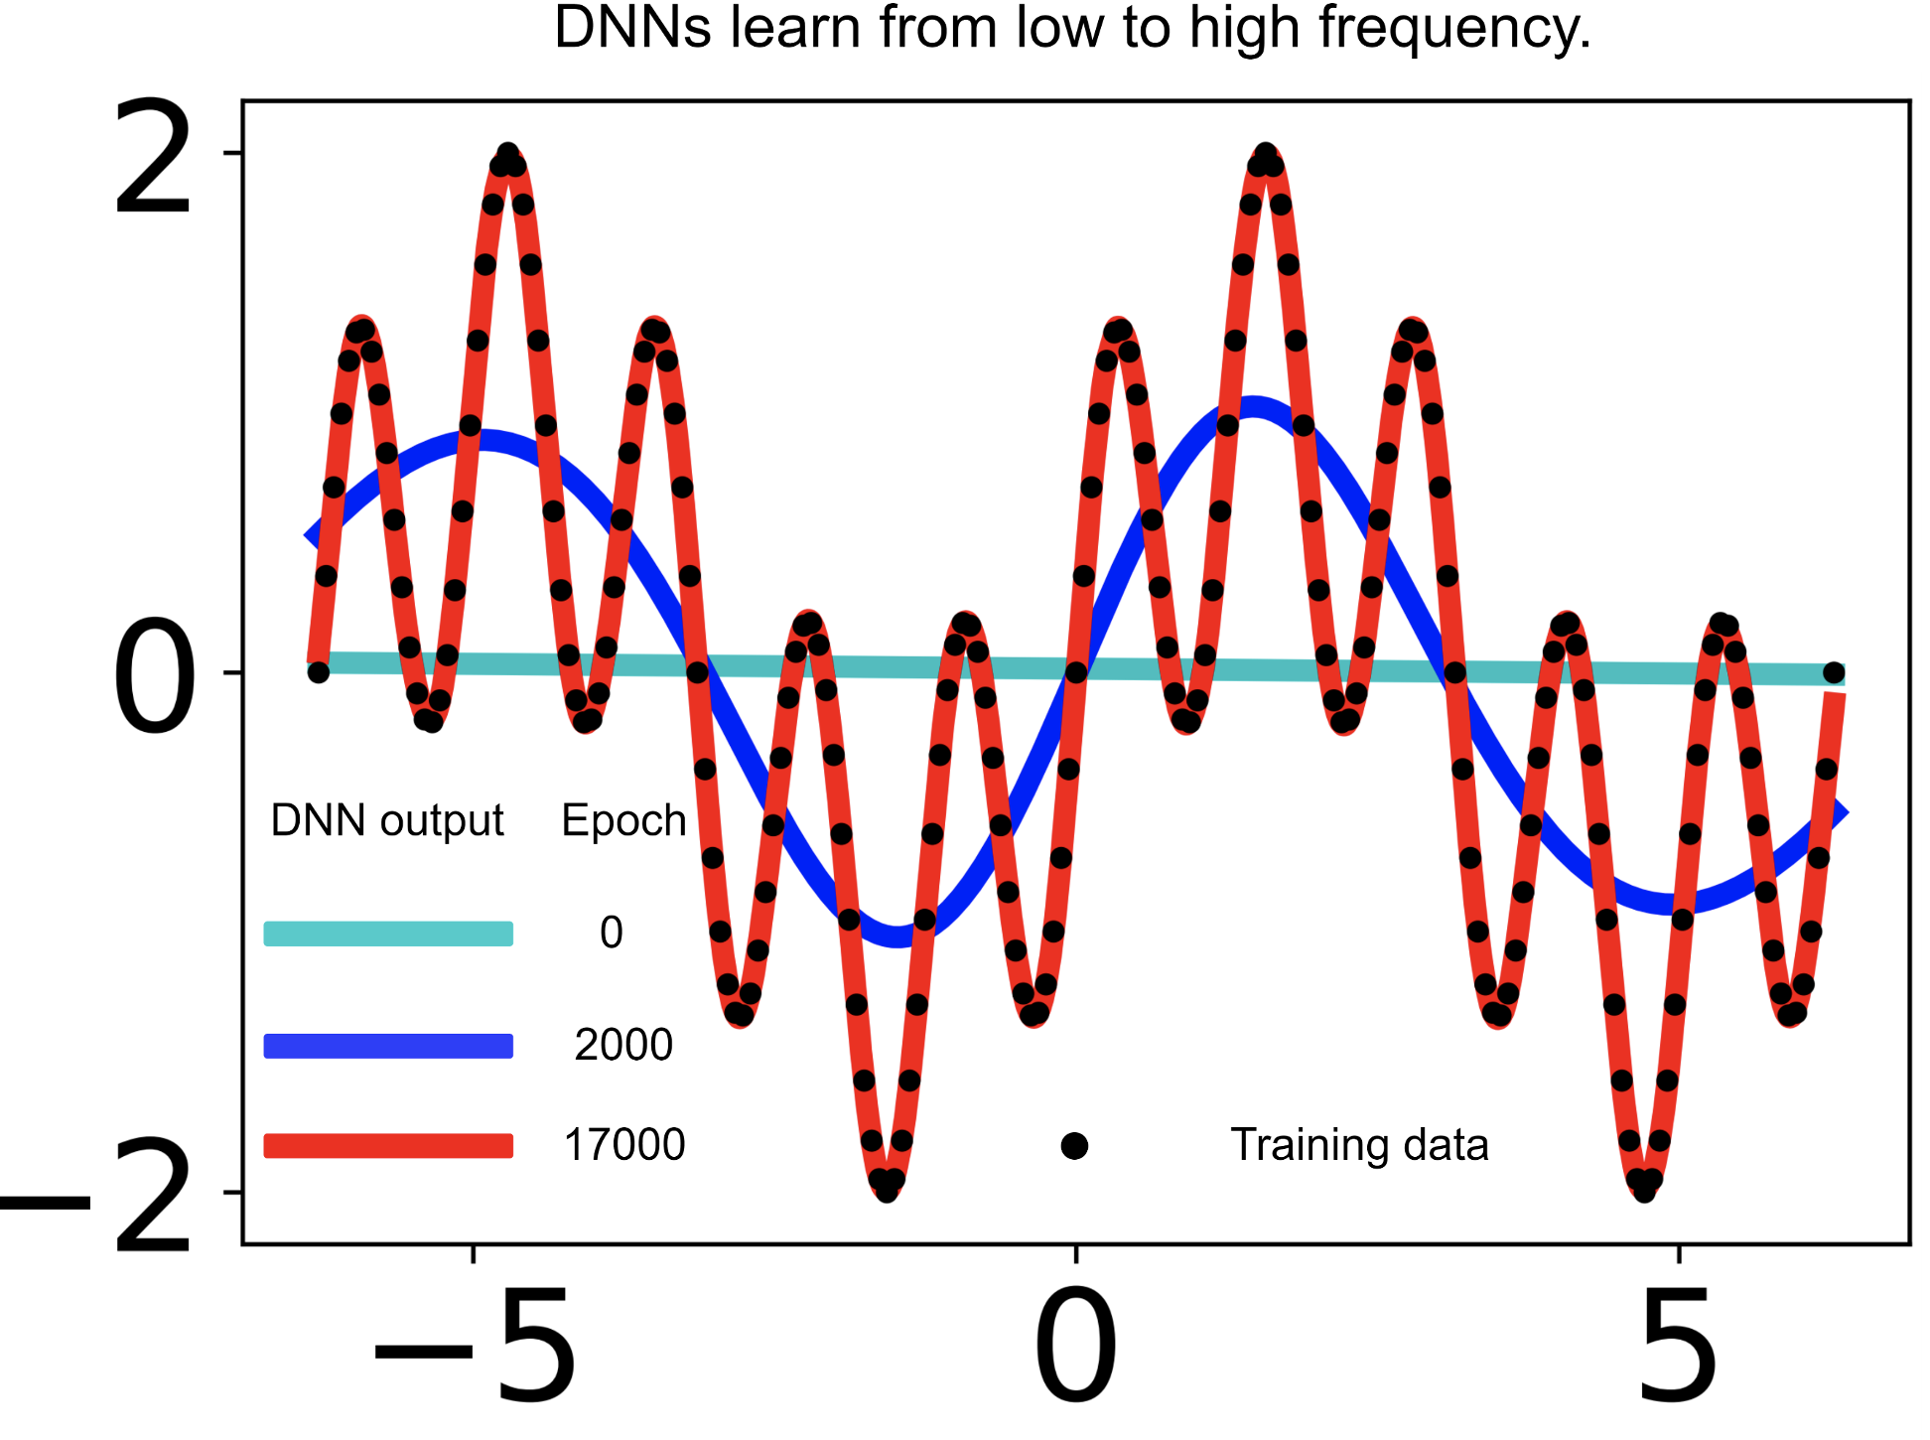
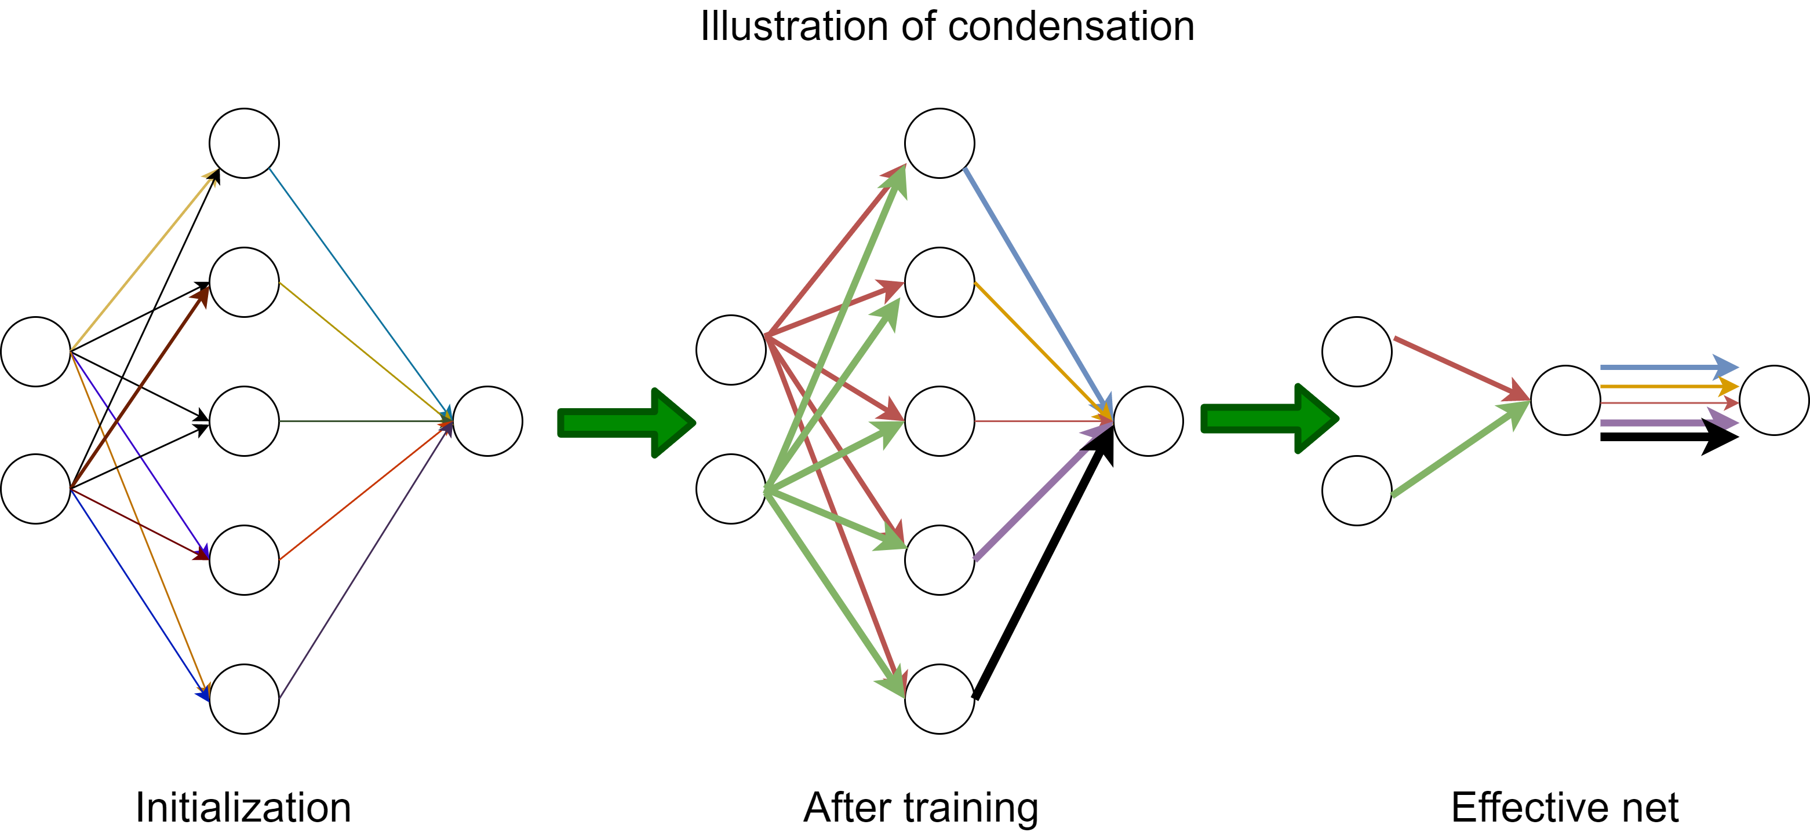
Simple bias in practice
Frequency Principle （频率原则）
Condensation
（参数凝聚）
Low-frequency bias
Few effective neurons

Slide 13
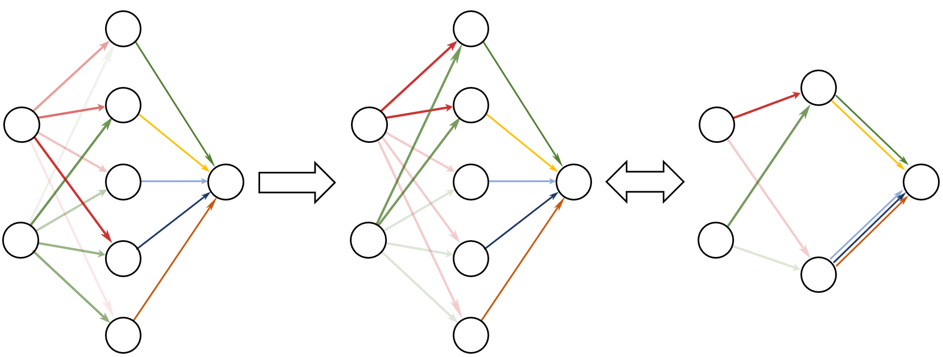
Condensation
Initial: Neurons different
After training: Clustered
Effective small net
Condense
Embedding
Luo#, Xu#, Ma, Zhang*, JMLR, 2021

Slide 14
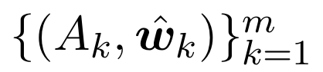
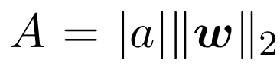
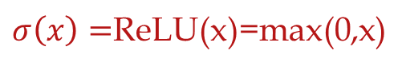
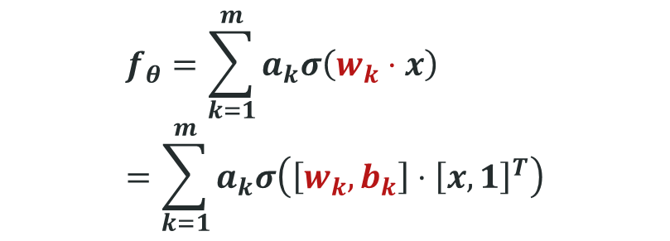

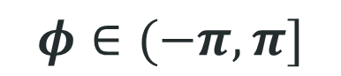
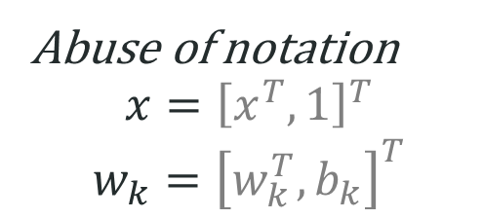
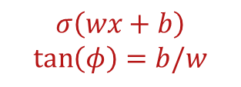
2-layer ReLU neural network
$$f_{θ}=\sum_{k=1}^{m}{a_{k}σ\left(w_{k}⋅x\right)}=\sum_{k=1}^{m}{a_{k}σ\left(\left[w_{k},b_{k}\right]⋅{\left[x,1\right]}^{T}\right)}$$
For 1d input, $w_{k}$ is a 2d vector.
We use $φ$ to denote its orientation
$σ\left(x\right)=$ReLU(x)=max(0,x)
Abuse of notation
$$x={\left[x^{T},1\right]}^{T}$$
$$w_{k}={\left[w_{k}^{T},b_{k}\right]}^{T}$$
$$σ\left(wx+b\right)$$
$$\tan\left(φ\right)=b/w$$
$$φ∈(−π,π]$$
Angle---Turning point
Tao Luo#, Zhi-Qin John Xu #, Zheng Ma, Yaoyu Zhang*,
Phase diagram for two-layer ReLU neural networks at infinite-width limit, Journal of Machine Learning Research (2021)

Slide 15
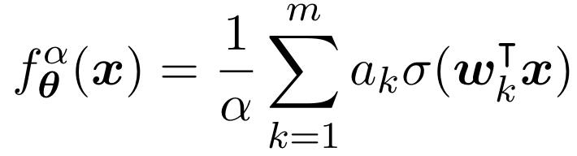
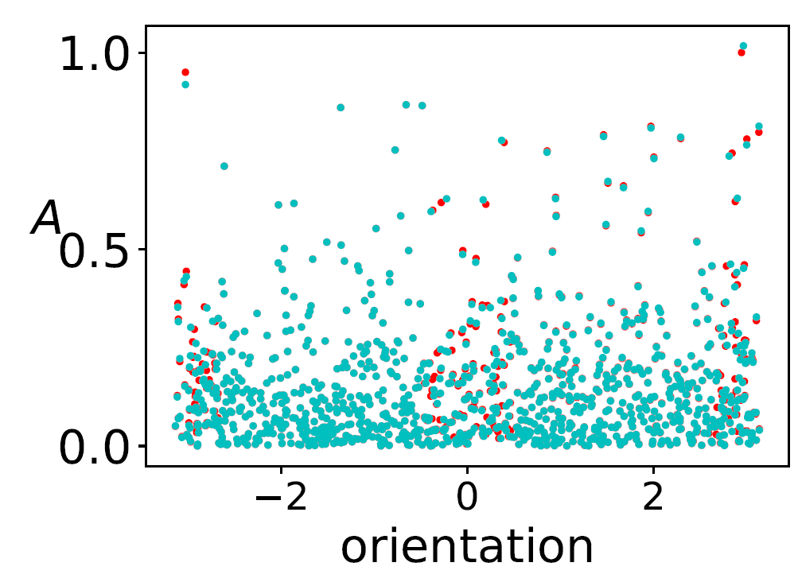
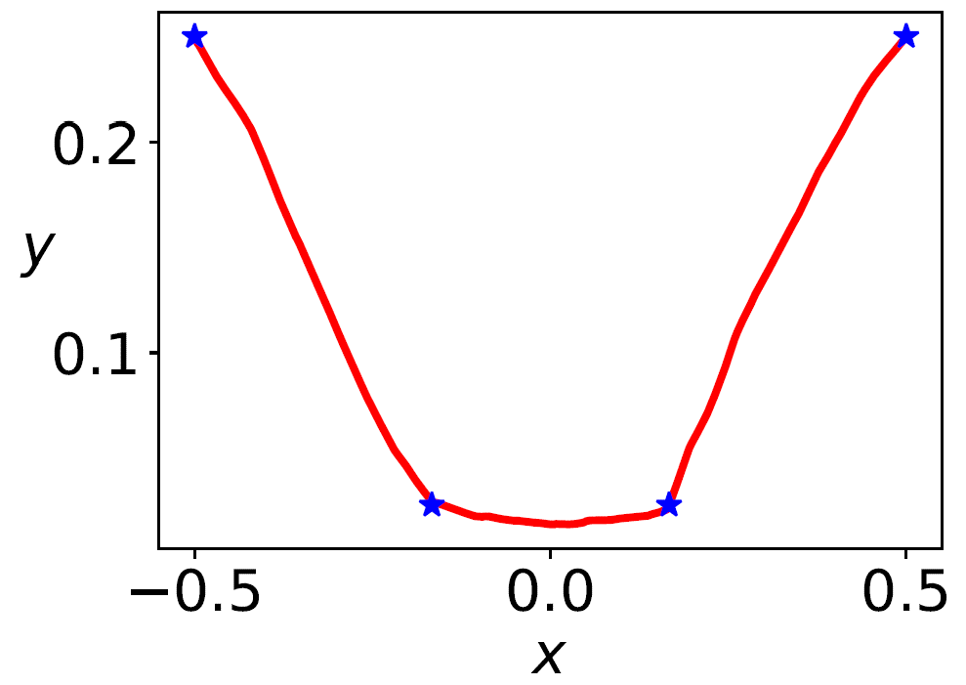
Linear regime
Initial→ → Final
However, NN’s power is not in linear regime.
Tao Luo#, Zhi-Qin John Xu #, Zheng Ma, Yaoyu Zhang*,
Phase diagram for two-layer ReLU neural networks at infinite-width limit, Journal of Machine Learning Research (2021)

Slide 16
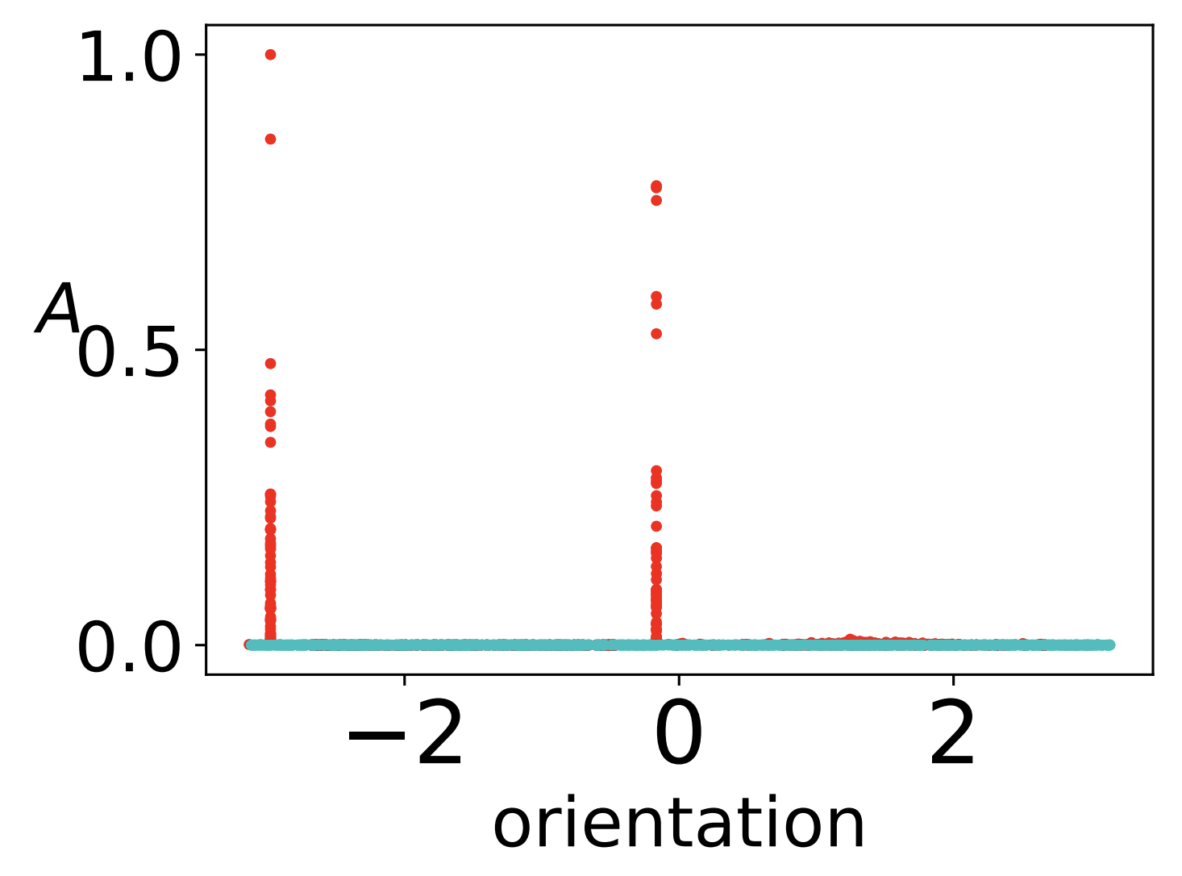
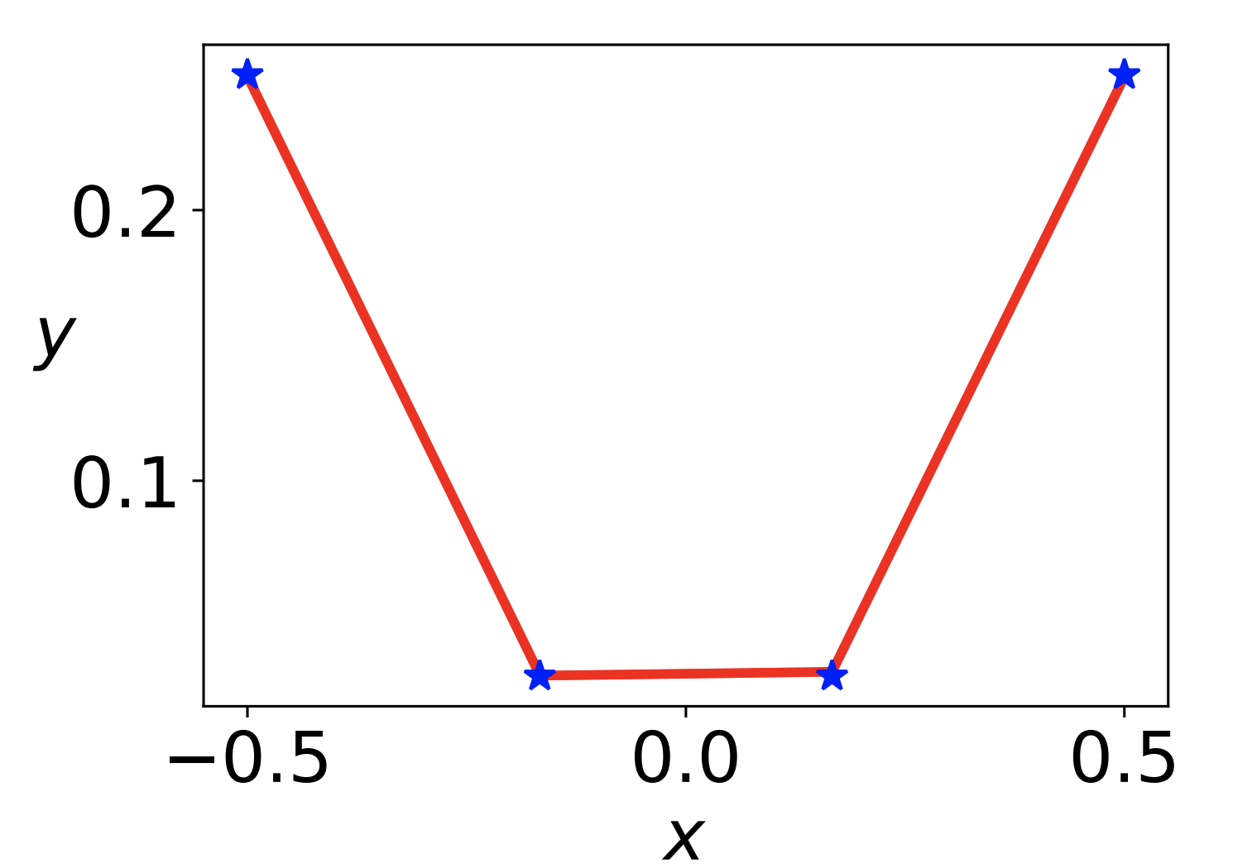
Condensation
Initial→ → Final
Tao Luo#, Zhi-Qin John Xu #, Zheng Ma, Yaoyu Zhang*,
Phase diagram for two-layer ReLU neural networks at infinite-width limit, Journal of Machine Learning Research (2021)

Slide 17
Picture of deep learning with implicit bias
initialization + loss + optimization dynamics
Low frequency
Linear regime
Non-Linear regime
Nearest
solution
Condensation
Global minima
Parameter space

Slide 18
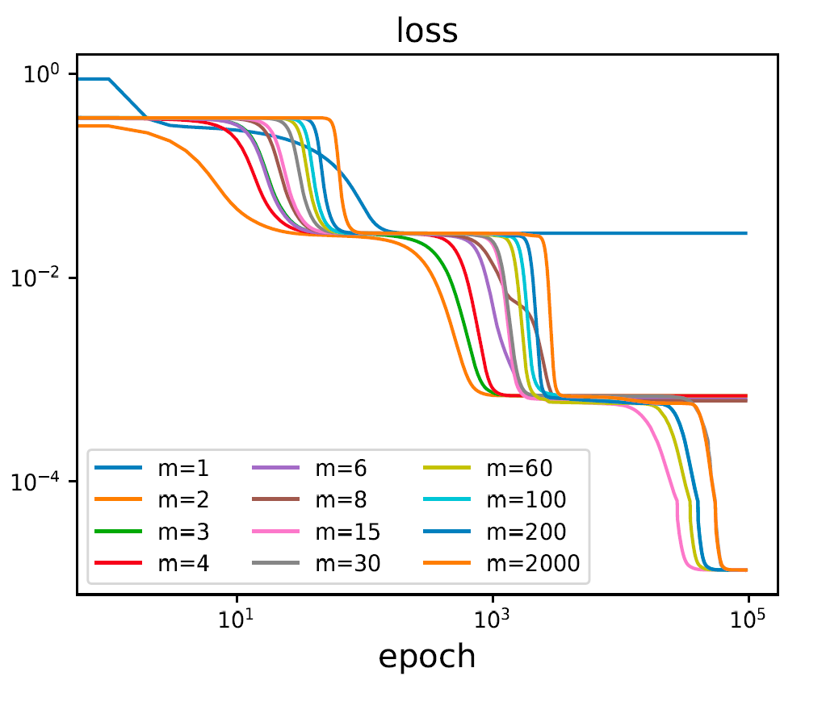
For GD, condensation requires small initialization. But training is too slow!

Slide 19
Can we find a way: Condensation and Fast training?

Slide 20
Dropout facilitates condensation in whole training! Even for large initialization!

Slide 21
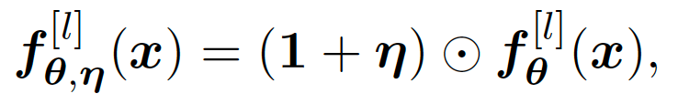
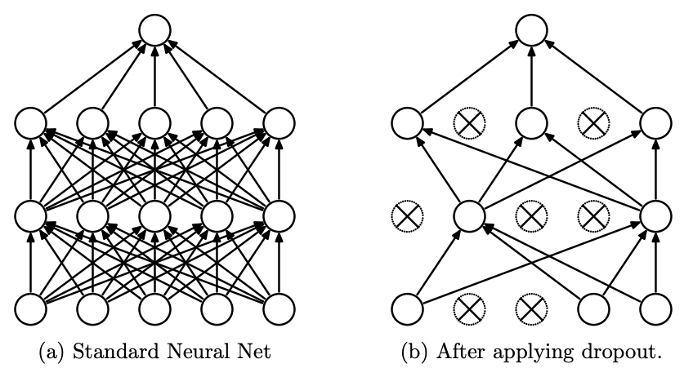
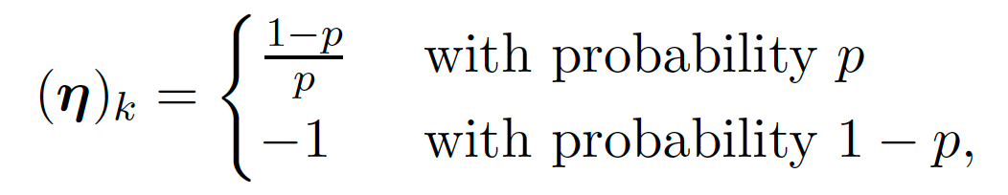
Dropout
If the dropout neurons are the same as those kept, nothing changed!
Srivastava et al., 2014 JMLR
Zhang and Xu*, Implicit regularization of dropout, arxiv: 2207.05952

Slide 22
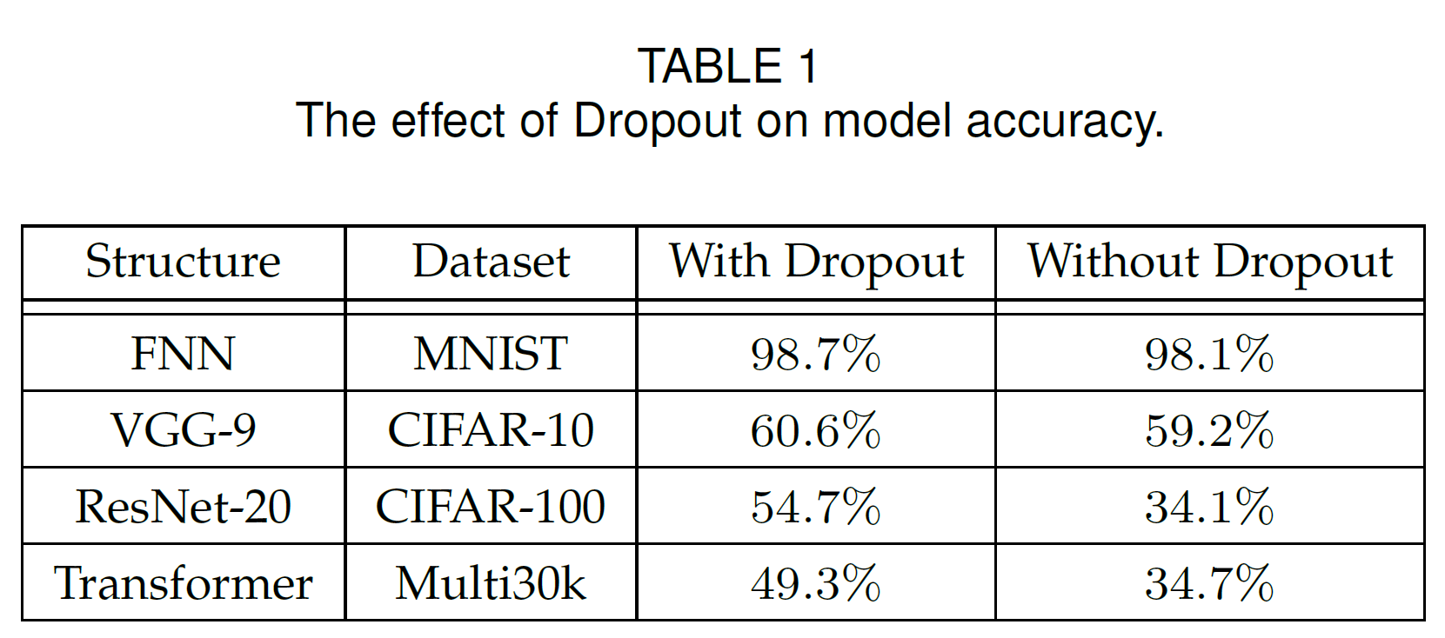
Dropout
What is implicit regularization of Dropout?
Zhang and Xu*, Implicit regularization of dropout, arxiv: 2207.05952
Notes:
we use ResNet-20 [39] to compare the loss landscape flatness w/o dropout layers. For experiments with dropout layers, we add dropout layers after the convolutional layers, the dropout rates of dropout
layers are 0.8.
Transformer: e apply dropout to the output of each sub-layer, before it is added to the sub-layer input and normalized.

Slide 23
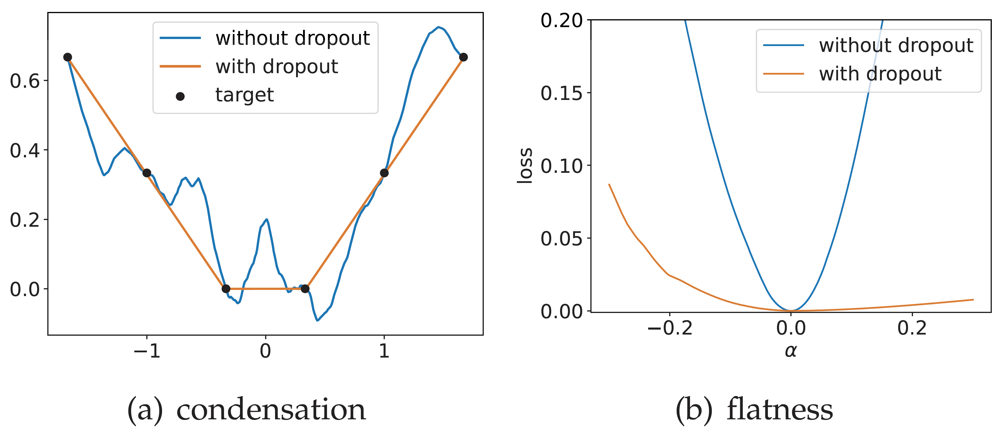
Condensation and flatness
Zhang and Xu*, Implicit regularization of dropout, arxiv: 2207.05952
Notes:
Two-layer ReLU NNs trained with and without dropout. The
width of the hidden layers is 1000, and the learning rate for different
experiments is 1 × 10−3. (a) The output of NNs with or without dropout.
(b) The loss value obtained by perturbing the network with or without
dropout in a given random direction, alpha is the step size moving in this
direction.

Slide 24
Visualize implicit regularization by modified gradient flow
Implicit regularization on condensation
Implicit regularization on flatness

Slide 25
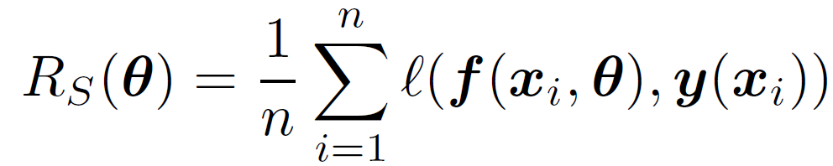
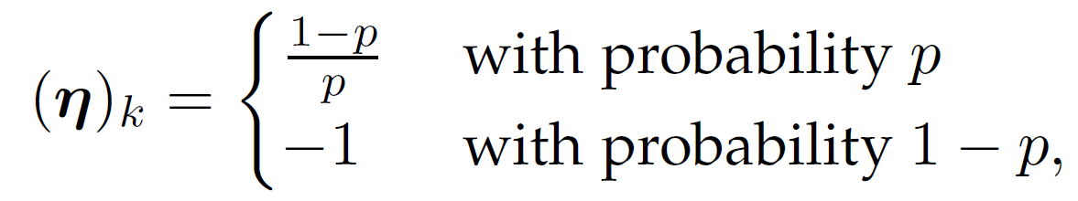
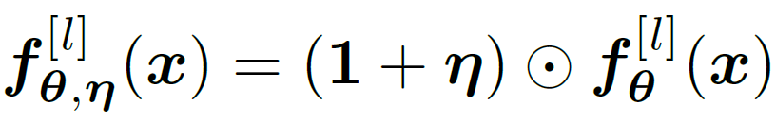
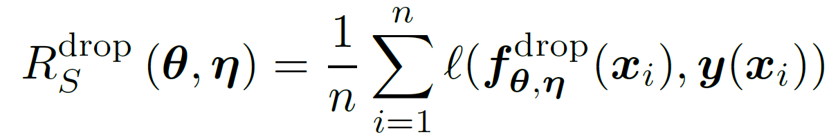
Dropout
Network
Loss function
Dropout variable
Dropout network
Dropout loss
Zhang and Xu*, Implicit regularization of dropout, arxiv: 2207.05952

Slide 26
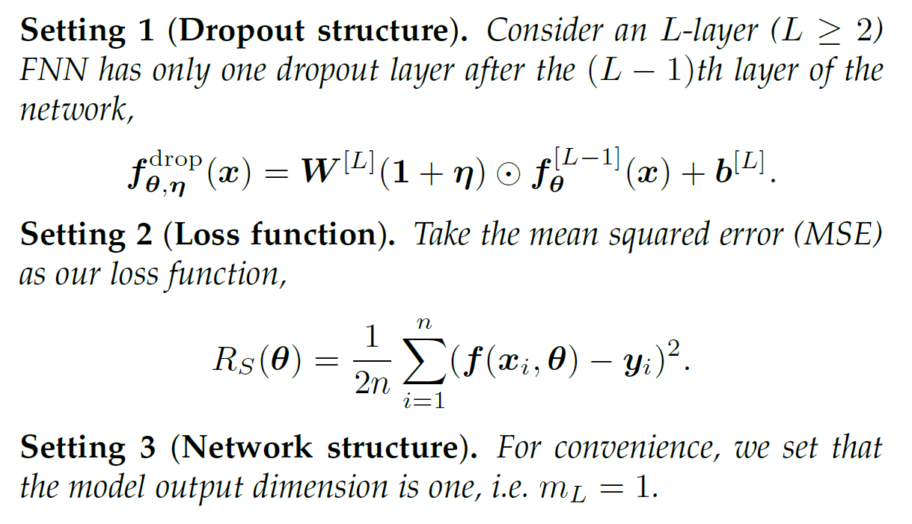
Dropout: theory settings
Zhang and Xu*, Implicit regularization of dropout, arxiv: 2207.05952

Slide 27
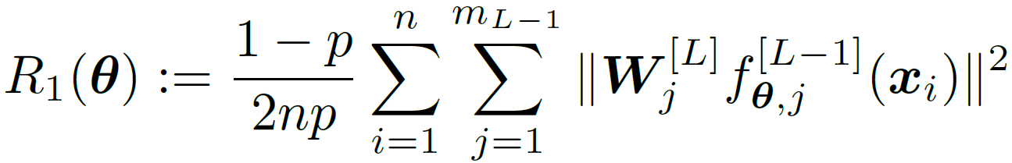
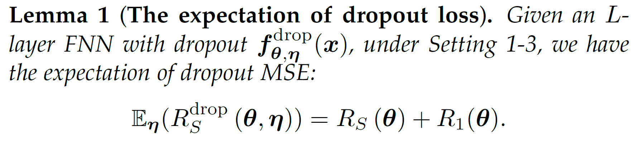
Dropout: Expected loss
Each sample
Each neuron’s output
Zhang and Xu*, Implicit regularization of dropout, arxiv: 2207.05952

Slide 28
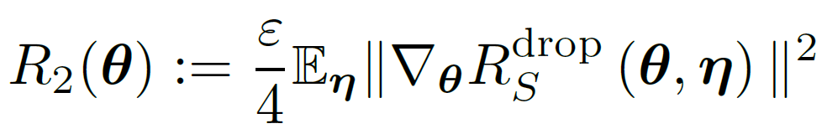
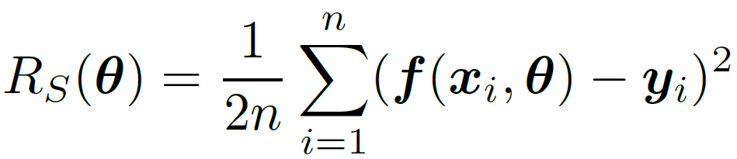
Modified gradient flow
Discretized gradient descent
Each sample
Each neuron’s output
Gradient flow
Modified gradient flow
Implicit regularization!
Zhang and Xu*, Implicit regularization of dropout, arxiv: 2207.05952

Slide 29
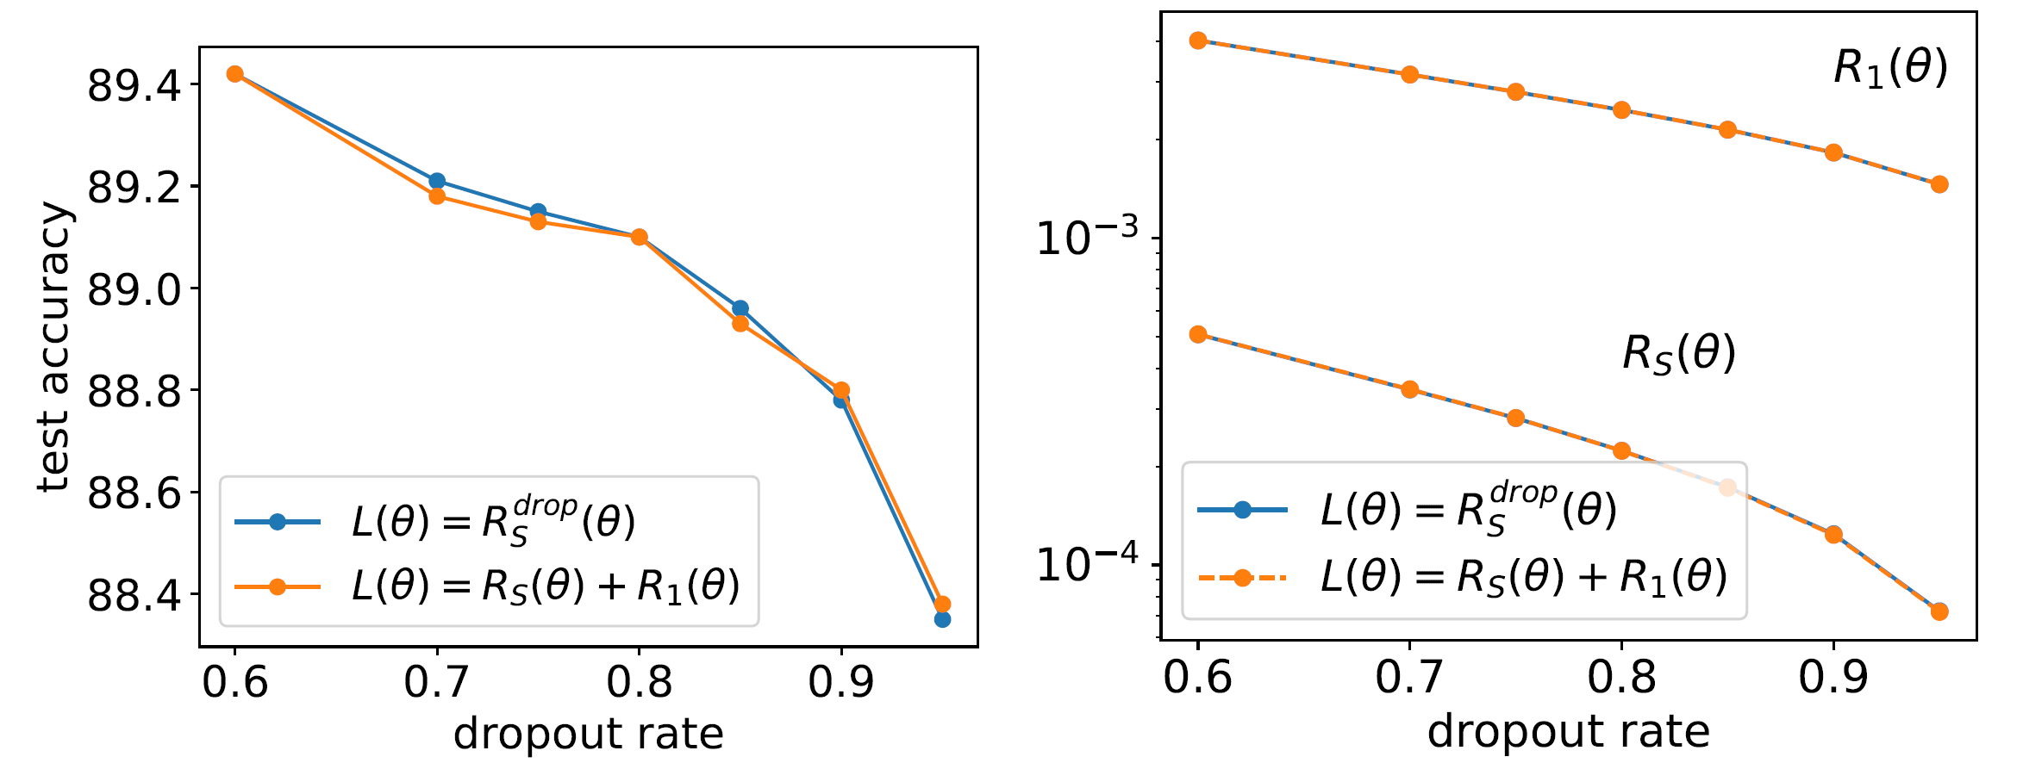

Validation of effect of $R_{1}(θ)$
Small learning rate $ε$
Two-layer NNs of width 1000,1000 images of MNIST
Zhang and Xu*, Implicit regularization of dropout, arxiv: 2207.05952

Slide 30
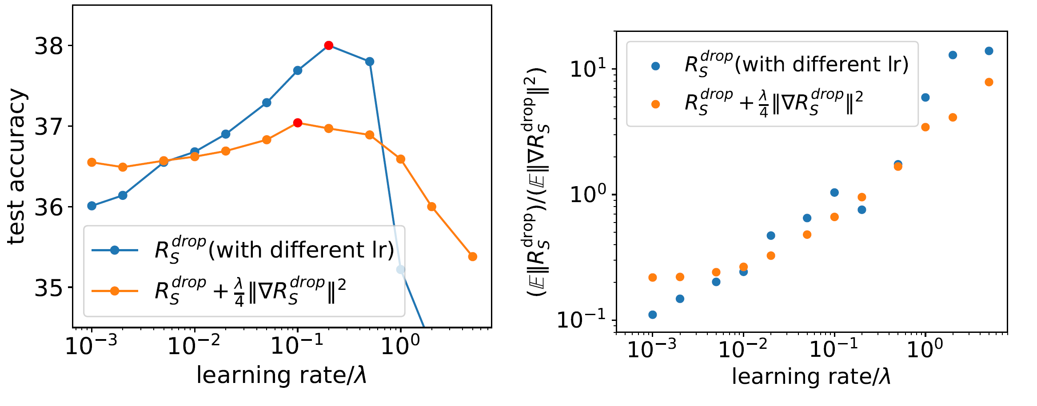
Validation of effect of $R_{2}(θ)$
VGG9, images of CIFAR-10
Zhang and Xu*, Implicit regularization of dropout, arxiv: 2207.05952

Slide 31
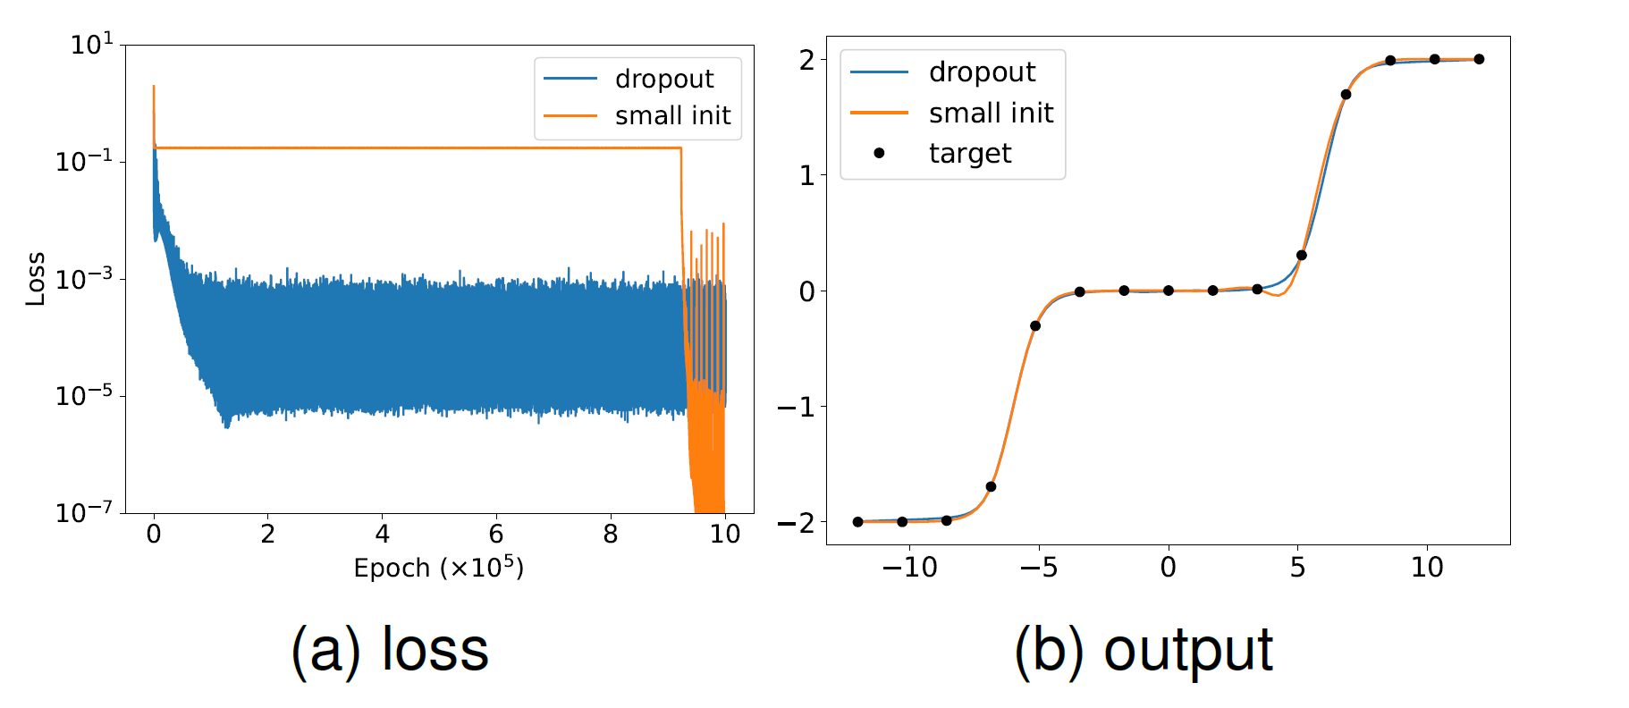
Dropout: condense+fast training

Slide 32
Visualize implicit regularization by modified gradient flow
Implicit regularization on condensation
Implicit regularization on flatness

Slide 33
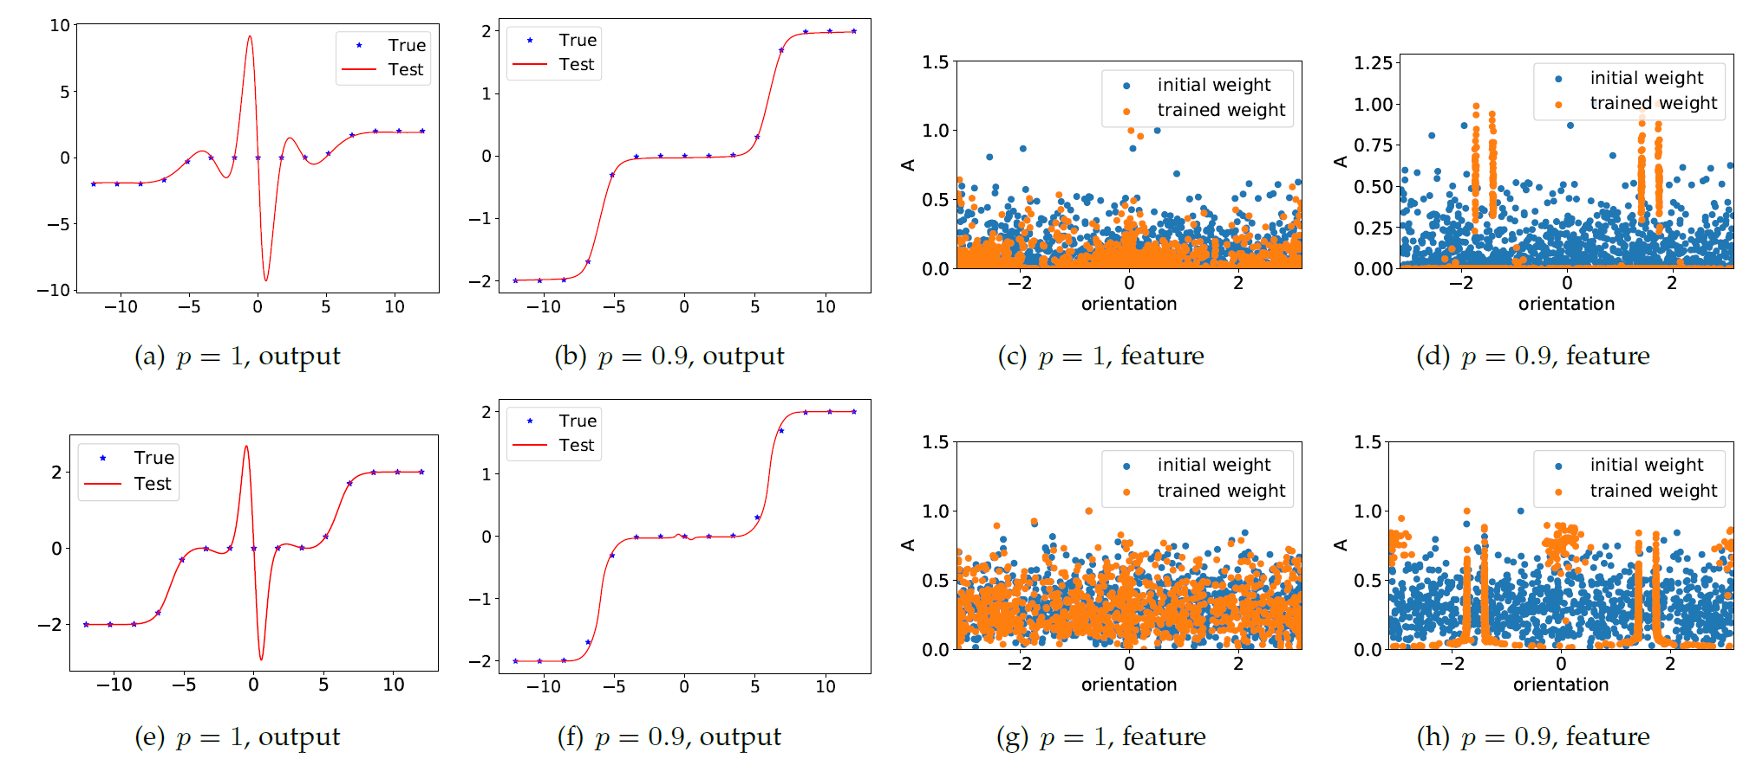
Dropout effect on condensation
Two-layer NNs
Three-layer NNs
width 1000
Zhang and Xu*, Implicit regularization of dropout, arxiv: 2207.05952

Slide 34
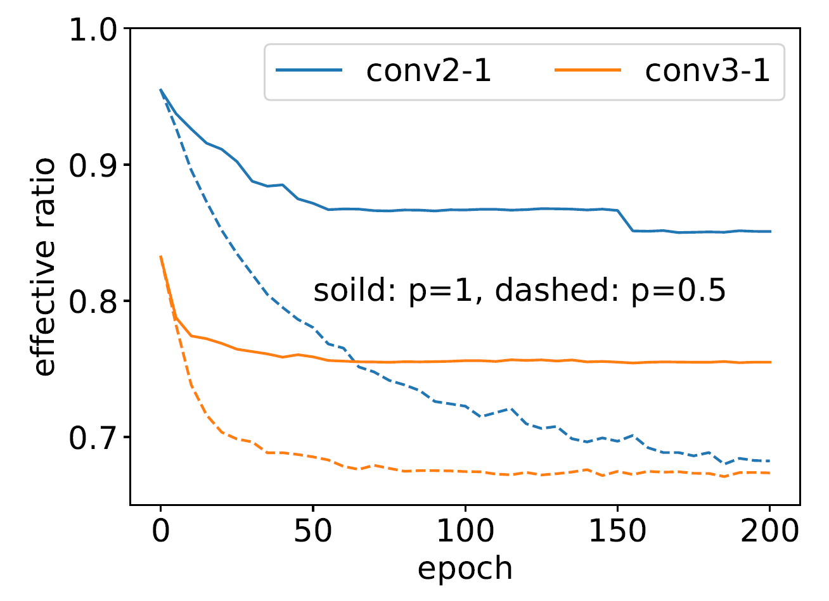
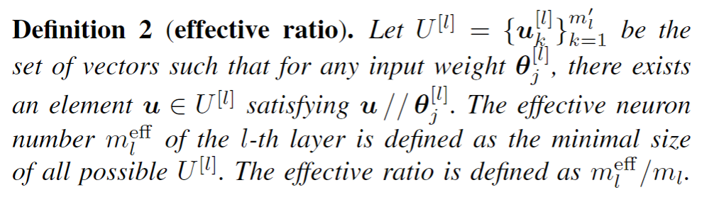
Dropout effect on condensation
Dropout network has fewer effective neurons.
Counted as one neuron if their inner product larger than 0.95.
CIFAR-10 classification with ResNet-18.
Zhang and Xu*, Implicit regularization of dropout, arxiv: 2207.05952

Slide 35
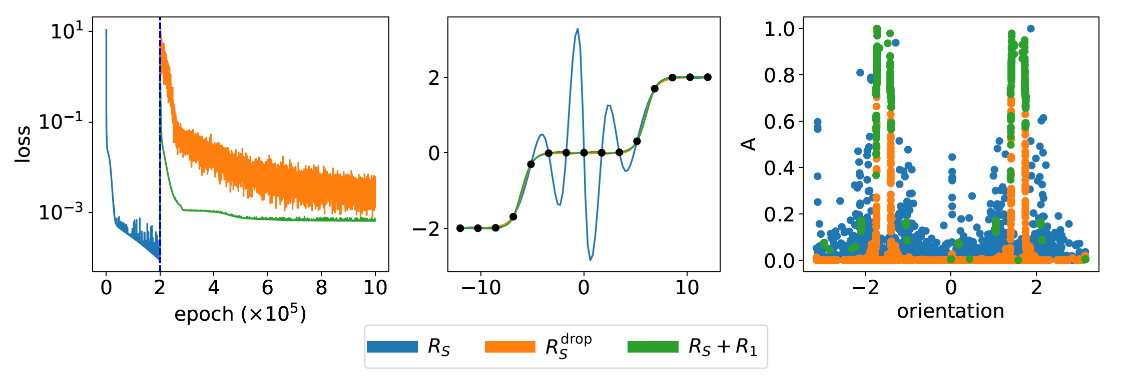
GD → GD+dropout
Zhang and Xu*, Implicit regularization of dropout, arxiv: 2207.05952

Slide 36
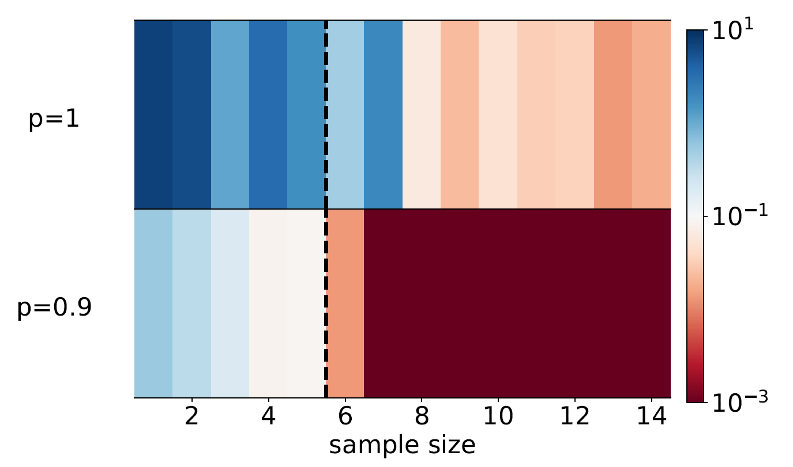
Dropout effect on generalization
Teacher student setup
Teacher network: two-layer tanh NN, width 2, 6 free parameters
Student network: two-layer tanh NN, width 1000, 3000 free parameters
Condensation: even large networks require few samples to generalize well!

Slide 37
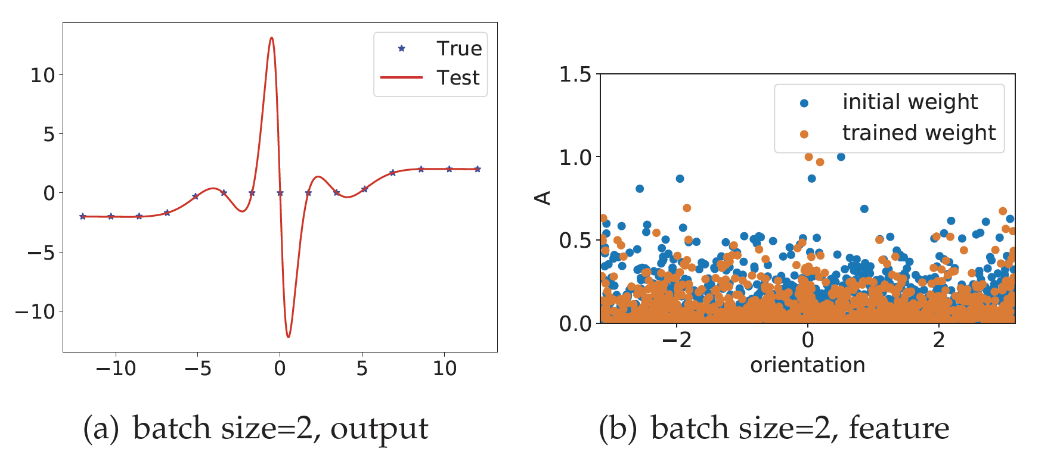
SGD NO effect on condensation
width 1000
Zhang and Xu*, Implicit regularization of dropout, arxiv: 2207.05952

Slide 38
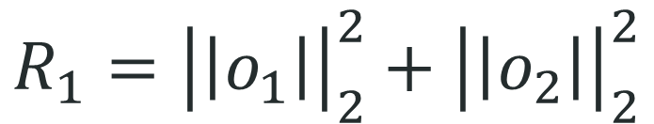
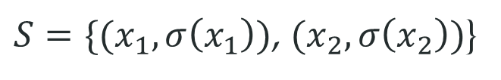
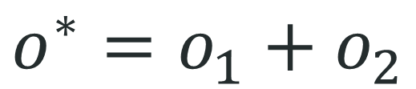
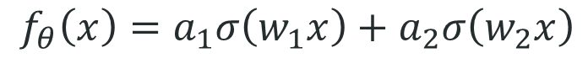
Implicit regularization of Dropout
model
$$f_{θ}\left(x\right)=a_{1}σ\left(w_{1}x\right)+a_{2}σ\left(w_{2}x\right)$$
Target data
$S=\{(x_{1},σ\left(x_{1}\right))$, $(x_{2},σ\left(x_{2}\right))$}
Perfect fitting
$$σ\left(x_{1}\right)=a_{1}σ\left(w_{1}x_{1}\right)+a_{2}σ\left(w_{2}x_{1}\right)$$
$$σ\left(x_{2}\right)=a_{1}σ\left(w_{1}x_{2}\right)+a_{2}σ\left(w_{2}x_{2}\right)$$
$$\left(σ\left(x_{1}\right),σ\left(x_{2}\right)\right)=(a_{1}σ\left(w_{1}x_{1}\right),a_{1}σ\left(w_{1}x_{2}\right))+(a_{2}σ\left(w_{2}x_{1}\right),a_{2}σ\left(w_{2}x_{2}\right))$$
$$o^{∗}=o_{1}+o_{2}$$
$$R_{1}={\left|\left|o_{1}\right|\right|}_{2}^{2}+{\left|\left|o_{2}\right|\right|}_{2}^{2}$$
Zhang and Xu*, Implicit regularization of dropout, arxiv: 2207.05952

Slide 39
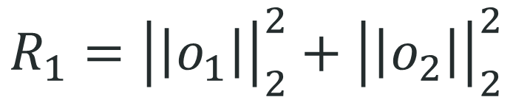

Implicit regularization of Dropout
$$o^{∗}=o_{1}+o_{2}$$
$$R_{1}={\left|\left|o_{1}\right|\right|}_{2}^{2}+{\left|\left|o_{2}\right|\right|}_{2}^{2}$$
Zhang and Xu*, Implicit regularization of dropout, arxiv: 2207.05952

Slide 40



Implicit regularization of Dropout
Minimal convexity changes
intercept point limit
Zhang and Xu*, Implicit regularization of dropout, arxiv: 2207.05952

Slide 41
Visualize implicit regularization by modified gradient flow
Implicit regularization on condensation
Implicit regularization on flatness

Slide 42

Dropout effect on flatness
Use method from H. Li, Z. Xu, G. Taylor, C. Studer, and T. Goldstein, “Visualizing
the loss landscape of neural nets,” arXiv preprint arXiv:1712.09913, 2017.

Slide 43

$R_{1}$ and $R_{2}$ on generalization
Two-layer NNs of width 1000,1000 images of MNIST

Slide 44





$R_{1}$ and $R_{2}$ on flatness
Two-layer NNs of width 1000,1000 images of MNIST

Slide 45



$R_{1}$ on flatness
$$∇R_{s}=\frac{1}{n}∑(f_{θ}\left(x_{i}\right)−f^{∗}\left(x_{i}\right))∇f_{θ}(x_{i})$$
$$∇^{2}R_{s}=\frac{1}{n}∑\left(f_{θ}\left(x_{i}\right)−f^{∗}\left(x_{i}\right)\right)∇^{2}f_{θ}\left(x_{i}\right)+\frac{1}{n}∑∇f_{θ}\left(x_{i}\right)∇^{T}f_{θ}(x_{i})$$
$$R_{s}\left(θ\right)=0$$

Slide 46
Visualize implicit regularization by modified gradient flow
小结
Implicit regularization on condensation
Implicit regularization on flatness

